Slide 1
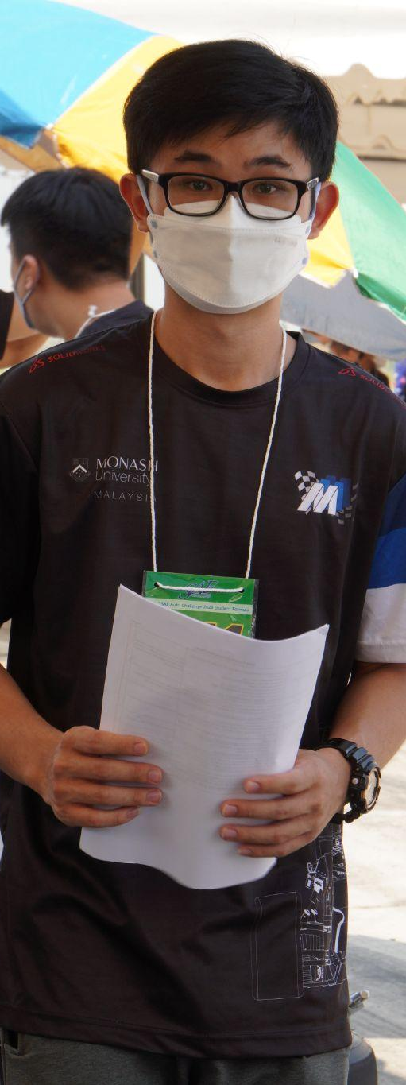
BIO
Despite working in the business industry, Robert's true passion lies in exploring the great outdoors and capturing the beauty of nature with his trusty smartphone. His motivation for hiking is deeply rooted in his desire to improve his physical and mental health. To him, hiking is more than just a form of exercise; it's a way to escape the stresses of work and city life.
Robert also values social engagement and sees hiking as an opportunity to meet and connect with like-minded individuals. He enjoys sharing his hiking routes and experiences with his friends and hopes to inspire them to join him on his hiking adventures. In fact, Robert is always looking for ways to improve his hiking experience, and he dreams of having a hiking app that would assist him in achieving his goals and provide updated information on the hiking trails.
Motivations
Skills
Fitness and health - improving overall health
Social engagement - socializing and interacting with others
Photography - taking photos hiking scenery
Destress - getting away from work
Intrinsic - hike as a hobby
Social engagement on an app
community features
Proficiency in reading
topographic map
Proficiency in reading online map
Social engagement
Photography
Robert Lee Wen Jie
Goals
Frustrations
27, Selangor, Malaysia
Plan more hiking trips together with friends
Share hiking trail histories with other hiker friends
Taking good photos of hiking sceneries through the hiking journey
Improving physical and mental health
Hike finish Broga Hills within an hour
Outdated information of the hiking trails from previous hiking applications
Previous hiking applications does not have maps for every hiking trail
FULL TIME EMPLOYMENT
^{NATIONALITY: MALAYSIAN}
^{MARITAL STATUS: SINGLE}
^{EMPLOYMENT: MARKET RESEARCHER}
^{FIELD OF EMPLOYMENT: BUSINESS}

Slide 2
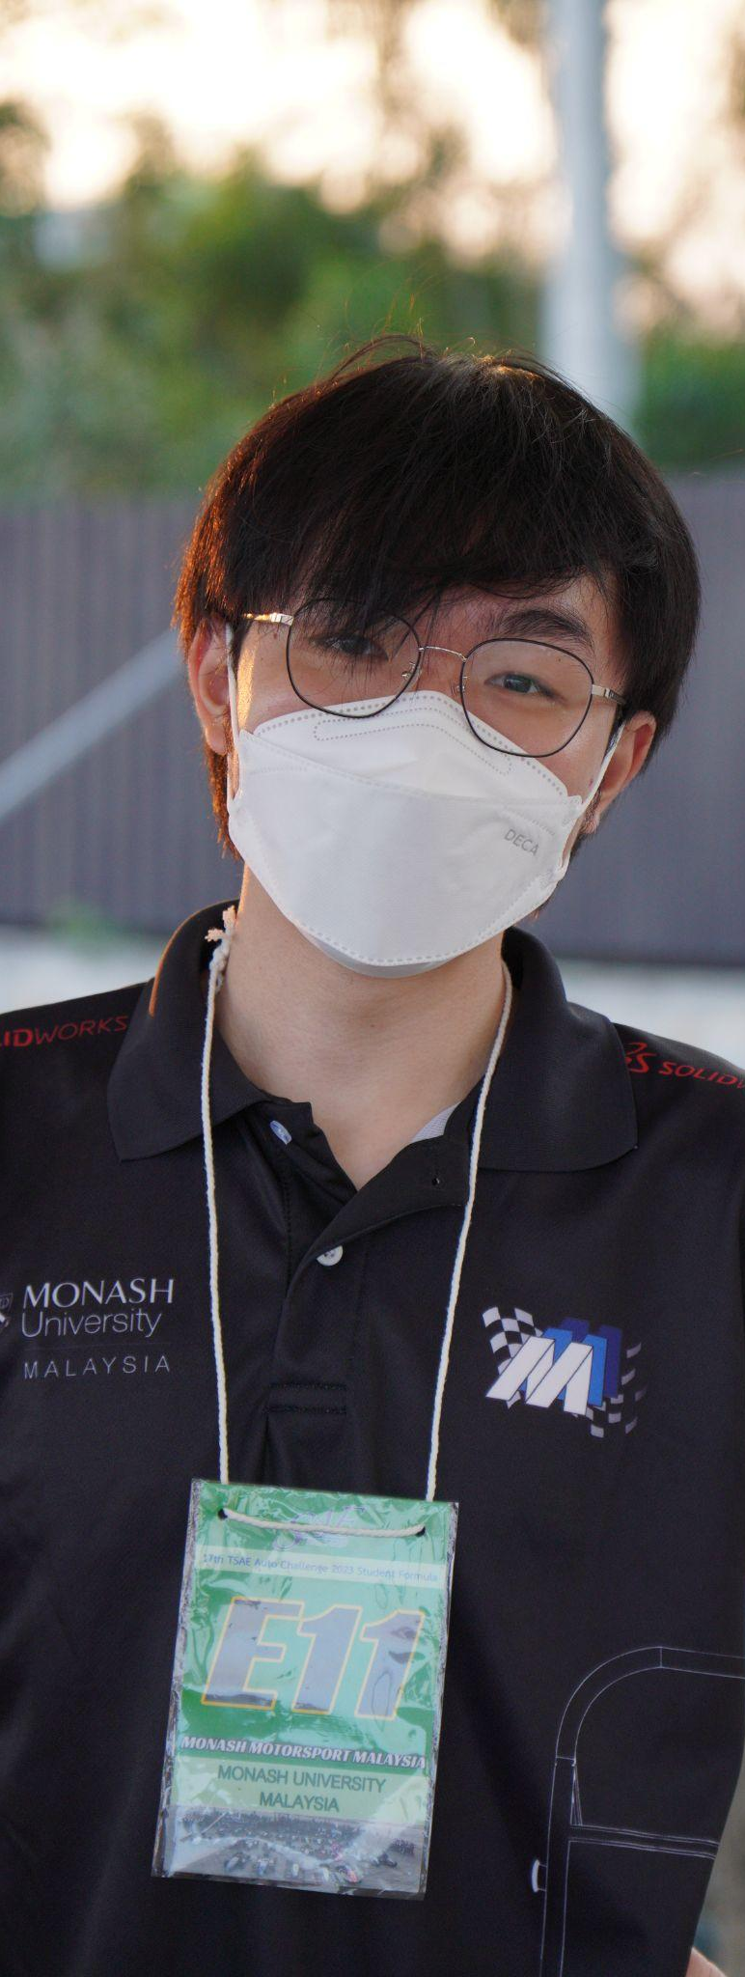
BIO
Despite working in the business industry, Robert's true passion lies in exploring the great outdoors and capturing the beauty of nature with his trusty smartphone. His motivation for hiking is deeply rooted in his desire to improve his physical and mental health. To him, hiking is more than just a form of exercise; it's a way to escape the stresses of work and city life.
Robert also values social engagement and sees hiking as an opportunity to meet and connect with like-minded individuals. He enjoys sharing his hiking routes and experiences with his friends and hopes to inspire them to join him on his hiking adventures. In fact, Robert is always looking for ways to improve his hiking experience, and he dreams of having a hiking app that would assist him in achieving his goals and provide updated information on the hiking trails.
Motivations
Skills
Fitness and health - improving overall health
Social engagement - socializing and interacting with others
Photography - taking photos hiking scenery
Destress - getting away from work
Intrinsic - hike as a hobby
Social engagement on an app
community features
Proficiency in reading
topographic map
Proficiency in reading online map
Social engagement
Photography
Robert Lee Wen Jie
Goals
Frustrations
27, Selangor, Malaysia
Plan more hiking trips together with friends
Share hiking trail histories with other hiker friends
Taking good photos of hiking sceneries through the hiking journey
Improving physical and mental health
Hike finish Broga Hills within an hour
Outdated information of the hiking trails from previous hiking applications
Previous hiking applications does not have maps for every hiking trail
FULL TIME EMPLOYMENT
^{NATIONALITY: MALAYSIAN}
^{MARITAL STATUS: SINGLE}
^{EMPLOYMENT: MARKET RESEARCHER}
^{FIELD OF EMPLOYMENT: BUSINESS}

Slide 3
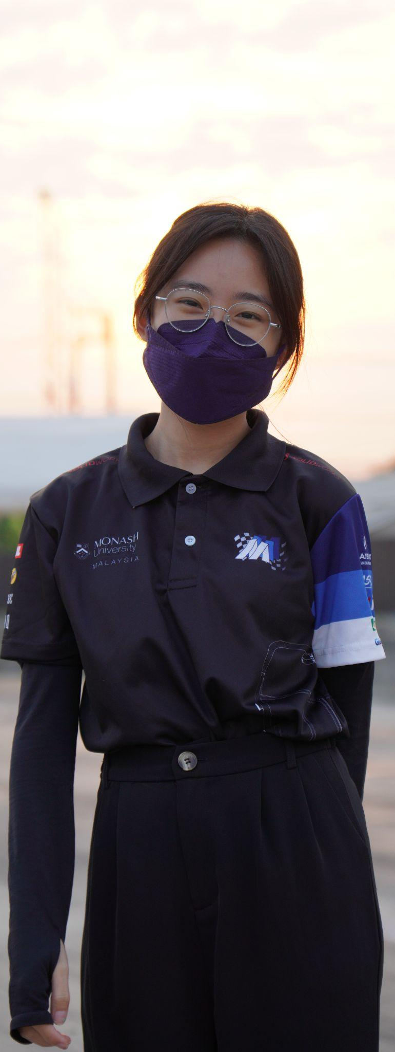
BIO
As a student, Michelle feels the pressure of academic life and views hiking as an escape from the demands of work. She enjoys the tranquility of hiking and being surrounded by nature, which helps her to unwind and de-stress. Nevertheless, she understands the value of social interaction and hopes to meet individuals who share her love for hiking.
Michelle's previous experience with hiking apps has been frustrating, as she has encountered outdated information and a lack of community engagement. She also found some apps too complicated to use, which hampered her ability to plan hiking trips effectively. Nevertheless, she remains determined to pursue her passion for hiking and is actively searching for a reliable and user-friendly hiking app that will enable her to achieve her goals while connecting with like-minded individuals.
Motivations
Skills
Social engagement - socialize and interacting with others
Achievement - gives a sense of accomplishment
Fitness and health - improving health
Photography - taking photos of hiking scenery
Destress - getting away from work
Intrinsic - hike as a hobby
Social engagement on an app
community features
Proficiency in reading
topographic map
Proficiency in reading online map
Social engagement
Photography
Michelle Chong Jie En
Goals
Frustrations
23, Selangor, Malaysia
Increase endurance, in order to hike longer in the future
Improve mental health
Taking good hiking sceneries
Reduce feelings of isolation and loneliness
Join a hiking group
Hike Gunung Tahan
Outdated information of hiking trail from previous hiking applications
Lack of community engagement from previous hiking applications
Previous hiking applications are too complex to use
STUDENT
^{NATIONALITY: MALAYSIAN}
^{MARITAL STATUS: SINGLE}
^{EMPLOYMENT: STUDENT}
FIELD OF EMPLOYMENT: LAW & POLICY

